Slide 1



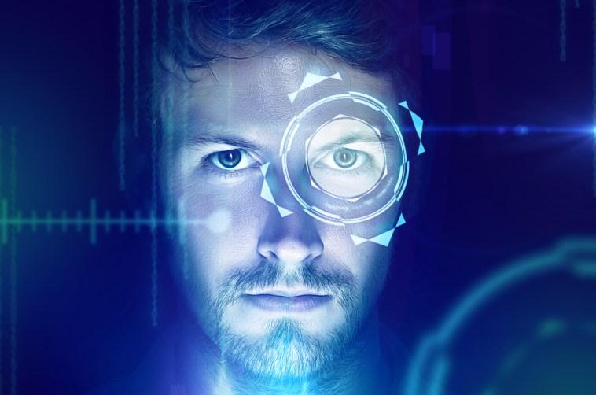
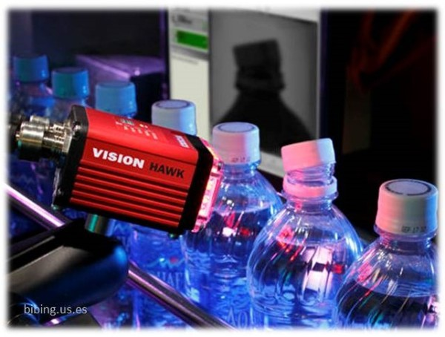
Visión Artificial con Python y OpenCV
Javier Advani Aguilar

Slide 2
IEEE and its members inspire a global community to innovate for a better tomorrow through highly cited publications, conferences, technology standards, and professional and educational activities. IEEE is the trusted “voice” for engineering, computing, and technology information around the globe.

Slide 3
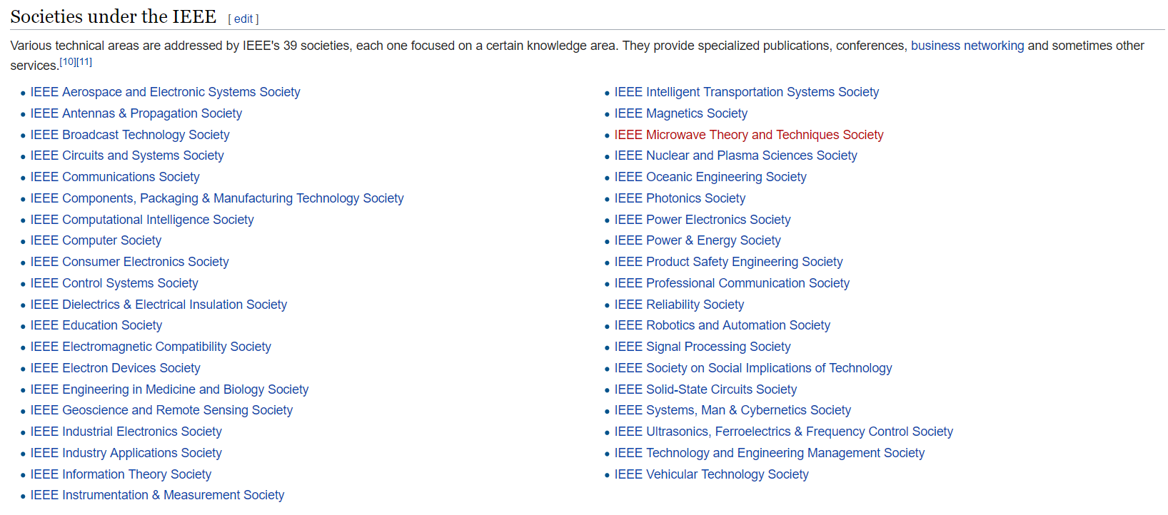

Slide 4
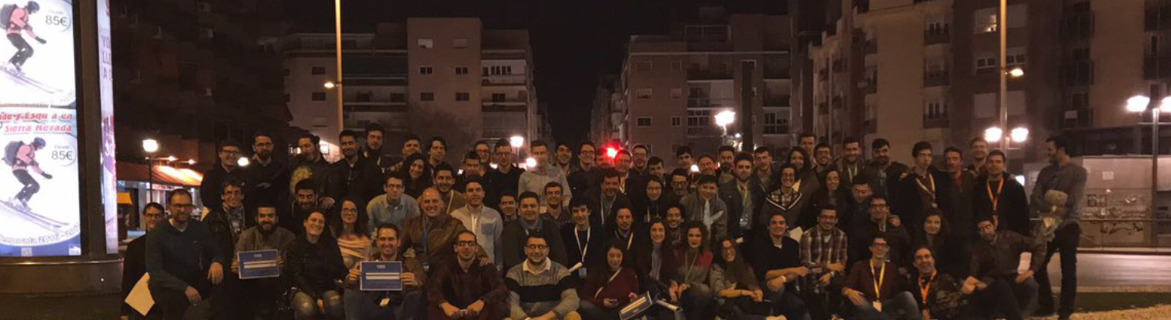
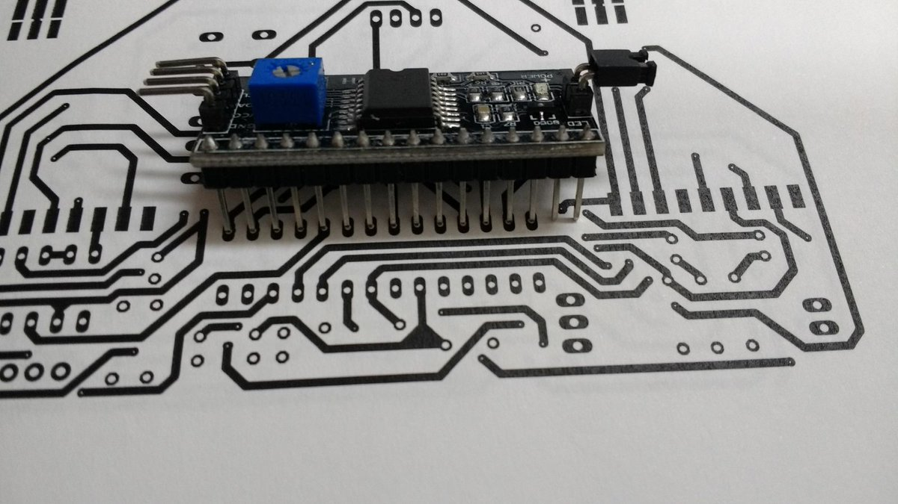

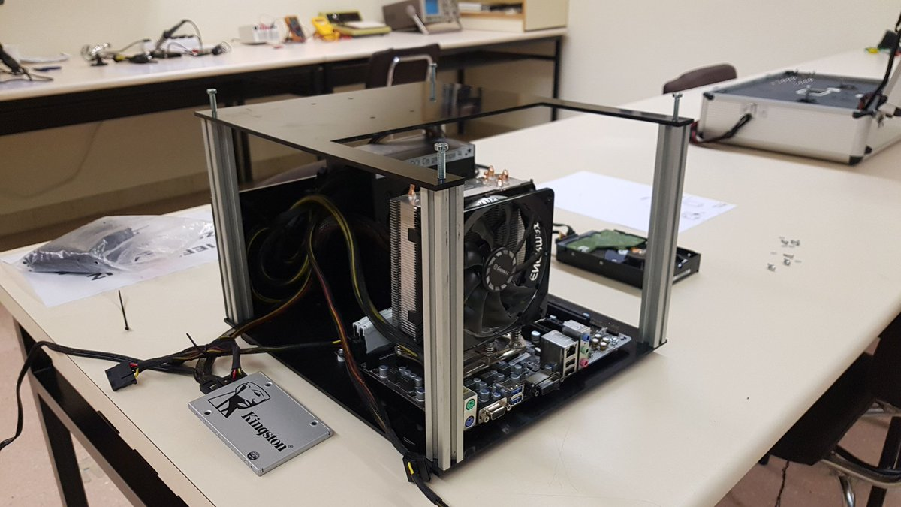

http://sites.ieee.org/sb-us/

Slide 5
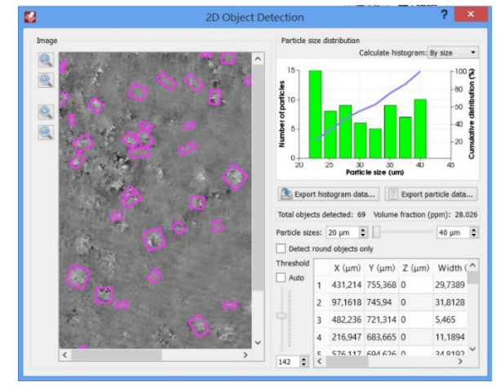

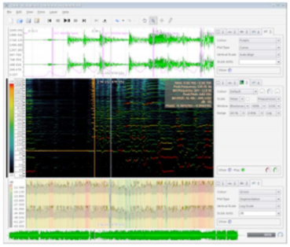
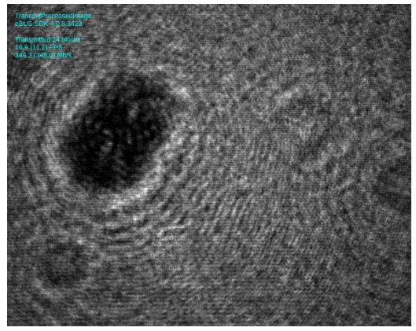
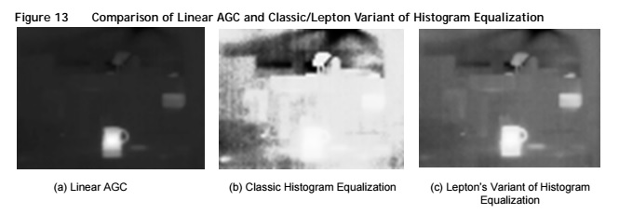
About me

Slide 6

¿Why Computer Vision?
Computer vision is an interdisciplinary field that deals with how computers can be made for gaining high-level understanding from digital images or videos. From the perspective of engineering, it seeks to automate tasks that the human visual system can do.

Slide 7
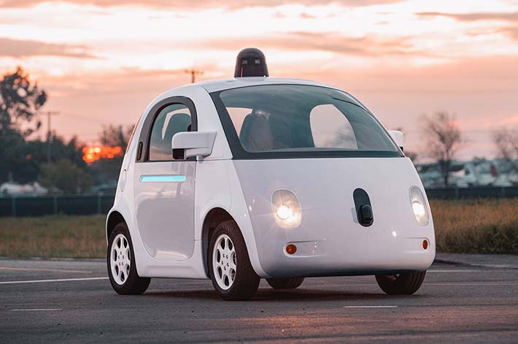
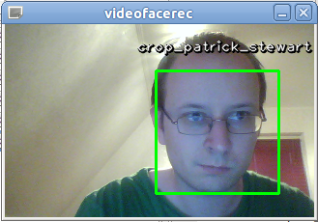
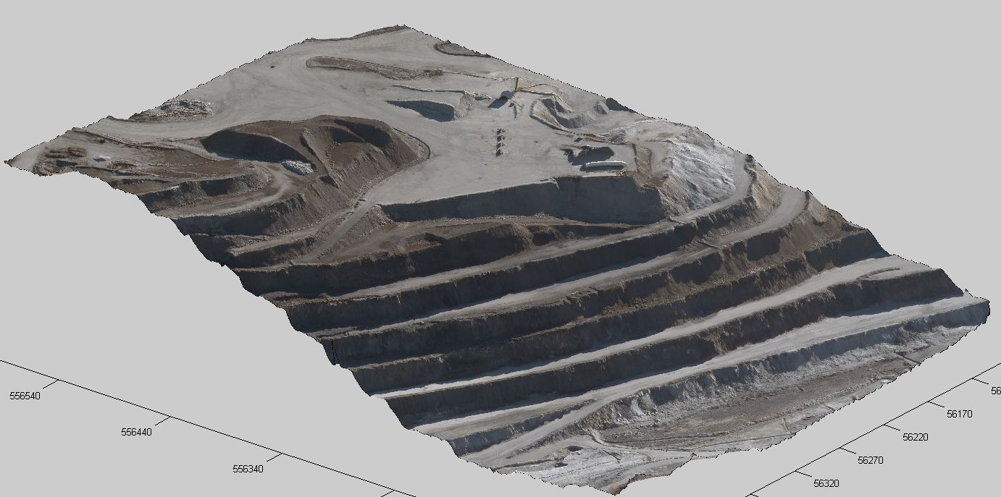

Some applications…
Face detection in cameras
Pedestrians, cars, road detection in smart (self-driving) cars
Terrain detection in drones and airplanes
Vehicle license plate scanners at security checkpoints
Object 3D scanning to digitize object’s physical appearance
Augmented reality (AR), mixed reality (MR) or hybrid reality (HR)

Slide 8
OpenCV
OpenCV (Open Source Computer Vision Library) is an open source computer vision and machine learning software library. OpenCV was built to provide a common infrastructure for computer vision applications and to accelerate the use of machine perception in the commercial products. Being a BSD-licensed product, OpenCV makes it easy for businesses to utilize and modify the code.
The library has more than 2500 optimized algorithms, which includes a comprehensive set of both classic and state-of-the-art computer vision and machine learning algorithms. These algorithms can be used to detect and recognize faces, identify objects, classify human actions in videos, track camera movements, track moving objects, extract 3D models of objects, produce 3D point clouds from stereo cameras, stitch images together to produce a high resolution image of an entire scene, find similar images from an image database, remove red eyes from images taken using flash, follow eye movements, recognize scenery and establish markers to overlay it with augmented reality, etc. OpenCV has more than 47 thousand people of user community and estimated number of downloads exceeding 14 million. The library is used extensively in companies, research groups and by governmental bodies.

Slide 9
Other CV Solutions
VLFeat: http://www.vlfeat.org/
Scikit-image (Python)
C++ toolkit for Image processing: http://cimg.eu/
SimpleCV (Python): http://simplecv.org/
Accord.NET : http://accord-framework.net/

Slide 10
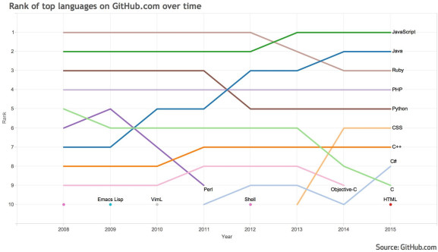
¿Why Python?
Open Source
Productivity
Performance
OOP management
Sintax logics

Slide 11

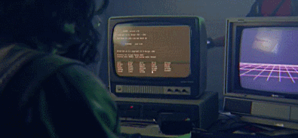
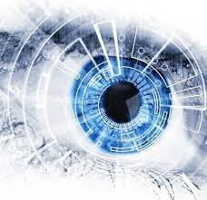
Let’s get started…

Slide 12
What are we going to do…
Basic Image Manipulations
image restoration
HDR
Color Detection
Advani’s mod: difference detector
Face recognition
Video Tracking with face recognition: Snapchat filters
Machine Learning with OpenCV (k-means)

